Slide 1
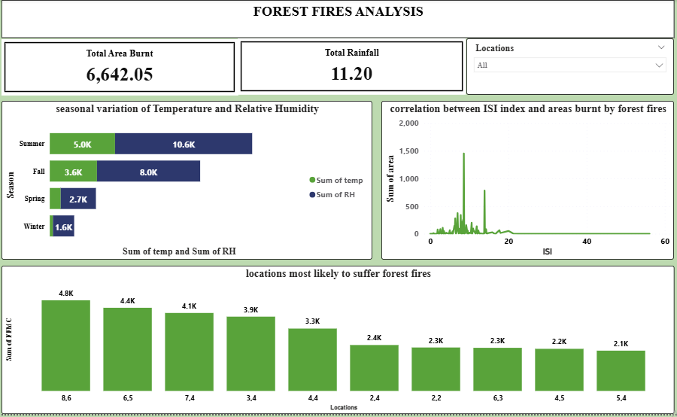
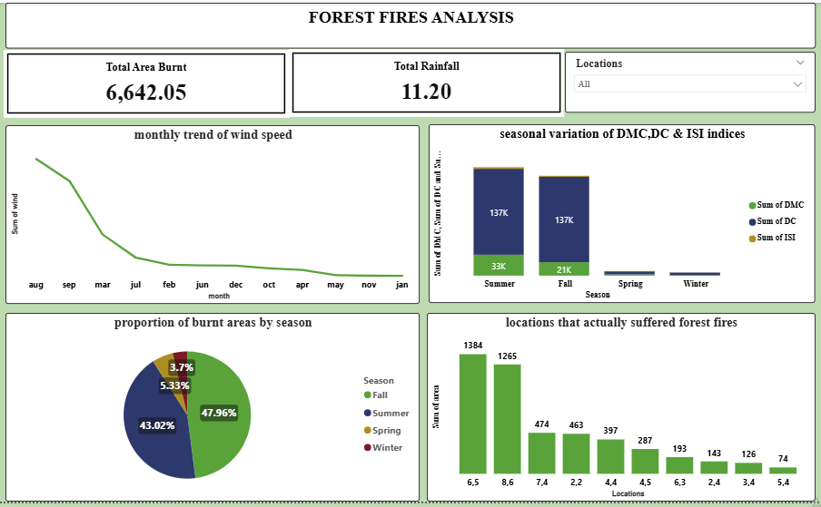
FOREST FIRES ANALYSIS EXECUTIVE SUMMARY
This report comprises an analysis of a forest fires dataset provided by ACA as part of a learning module
The analysis was done by first cleaning and transforming the data on Microsoft Excel, then analyzing the data on Microsoft SQL and Visualizing on Microsoft Power BI

